Slide 1

KenyaKidsCan.org

Slide 2
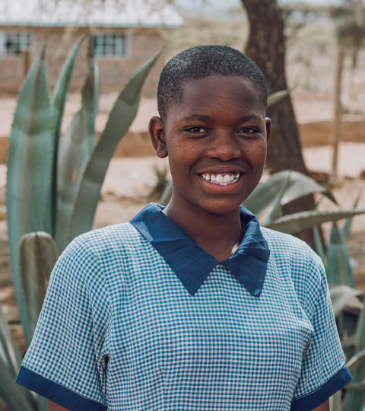
MEET LISA,
an eighth grader at
Ewuaso Primary School.
She has four brothers and one sister.
It takes 1 hour for her to walk to school. Lisa loves computer class because it helps her learn math.

Slide 3
Lisa hopes to be a lawyer because she wants people to have justice.

Slide 4


Slide 5
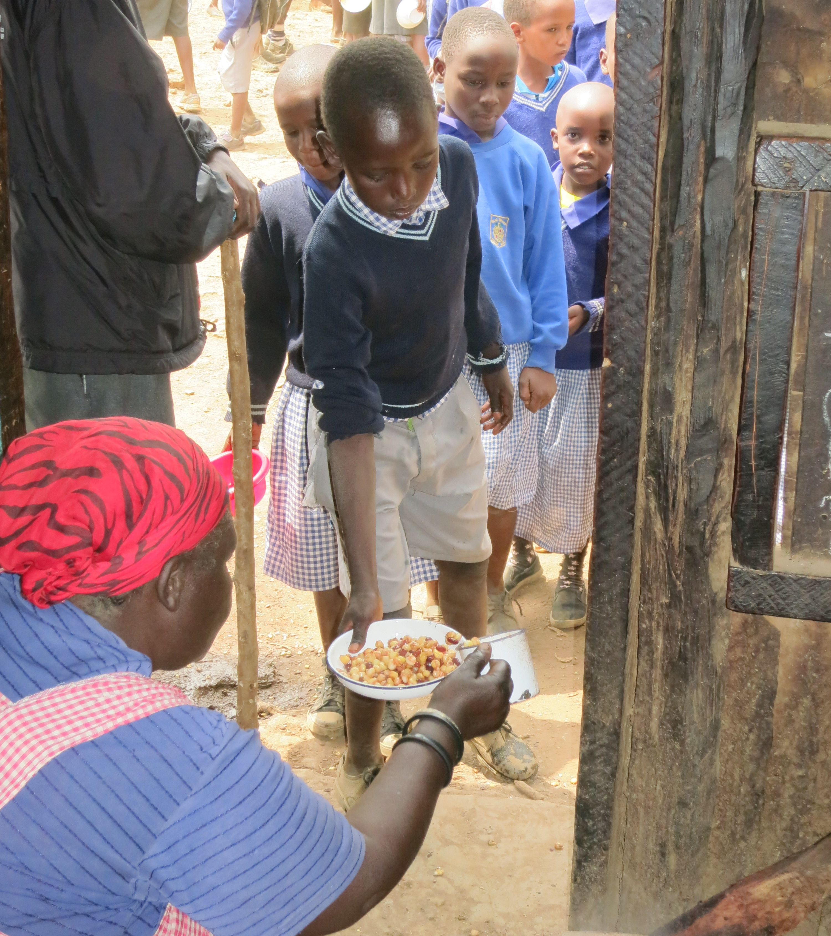
SCHOOL LUNCH PROGRAM
Kenya Kids Can partners with Lisa’s community to provide students with hot githeri lunches.

Slide 6
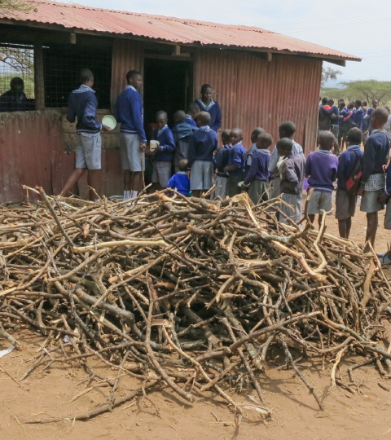
At rural schools like Ewuaso, students bring sticks to school to fuel the fires that cook their lunches.

Slide 7
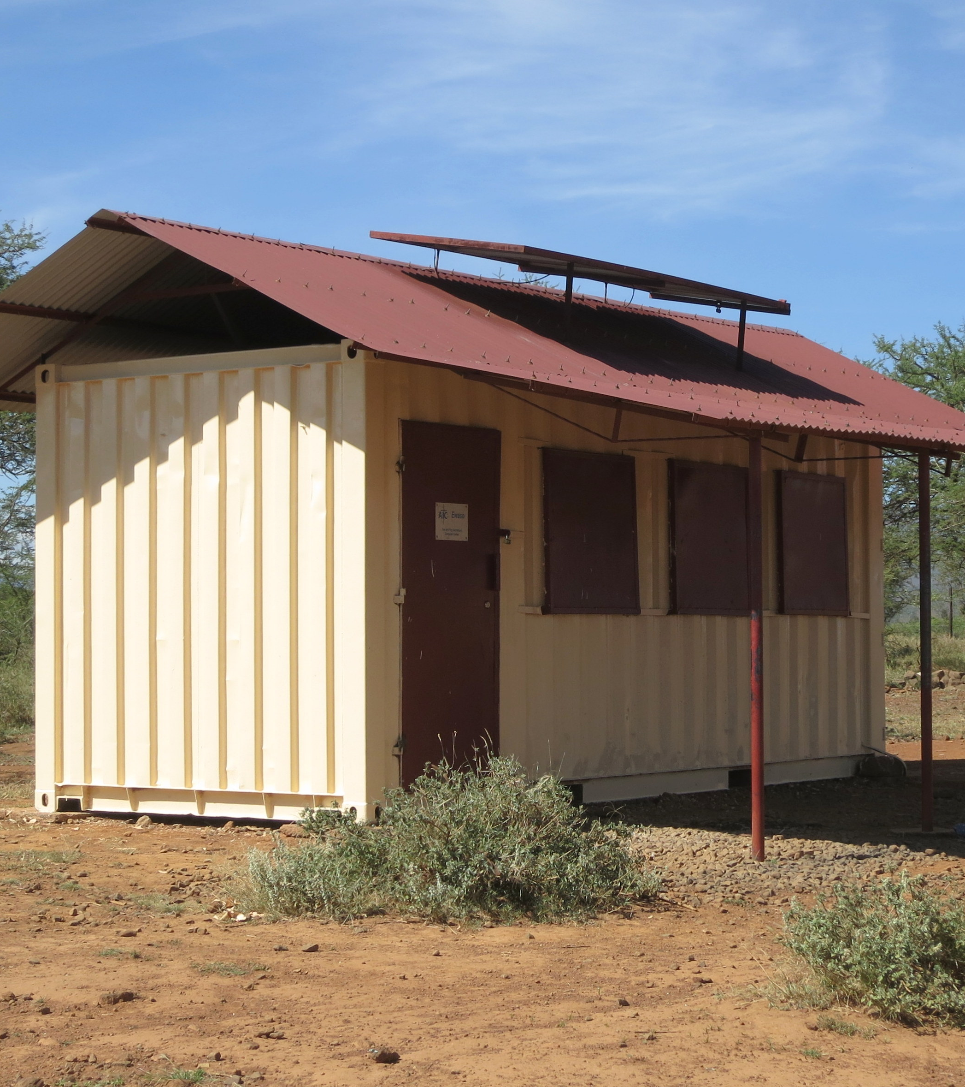
COMPUTER CENTERS
Kenya Kids Can also operates a computer center in Lisa’s school.

Slide 8
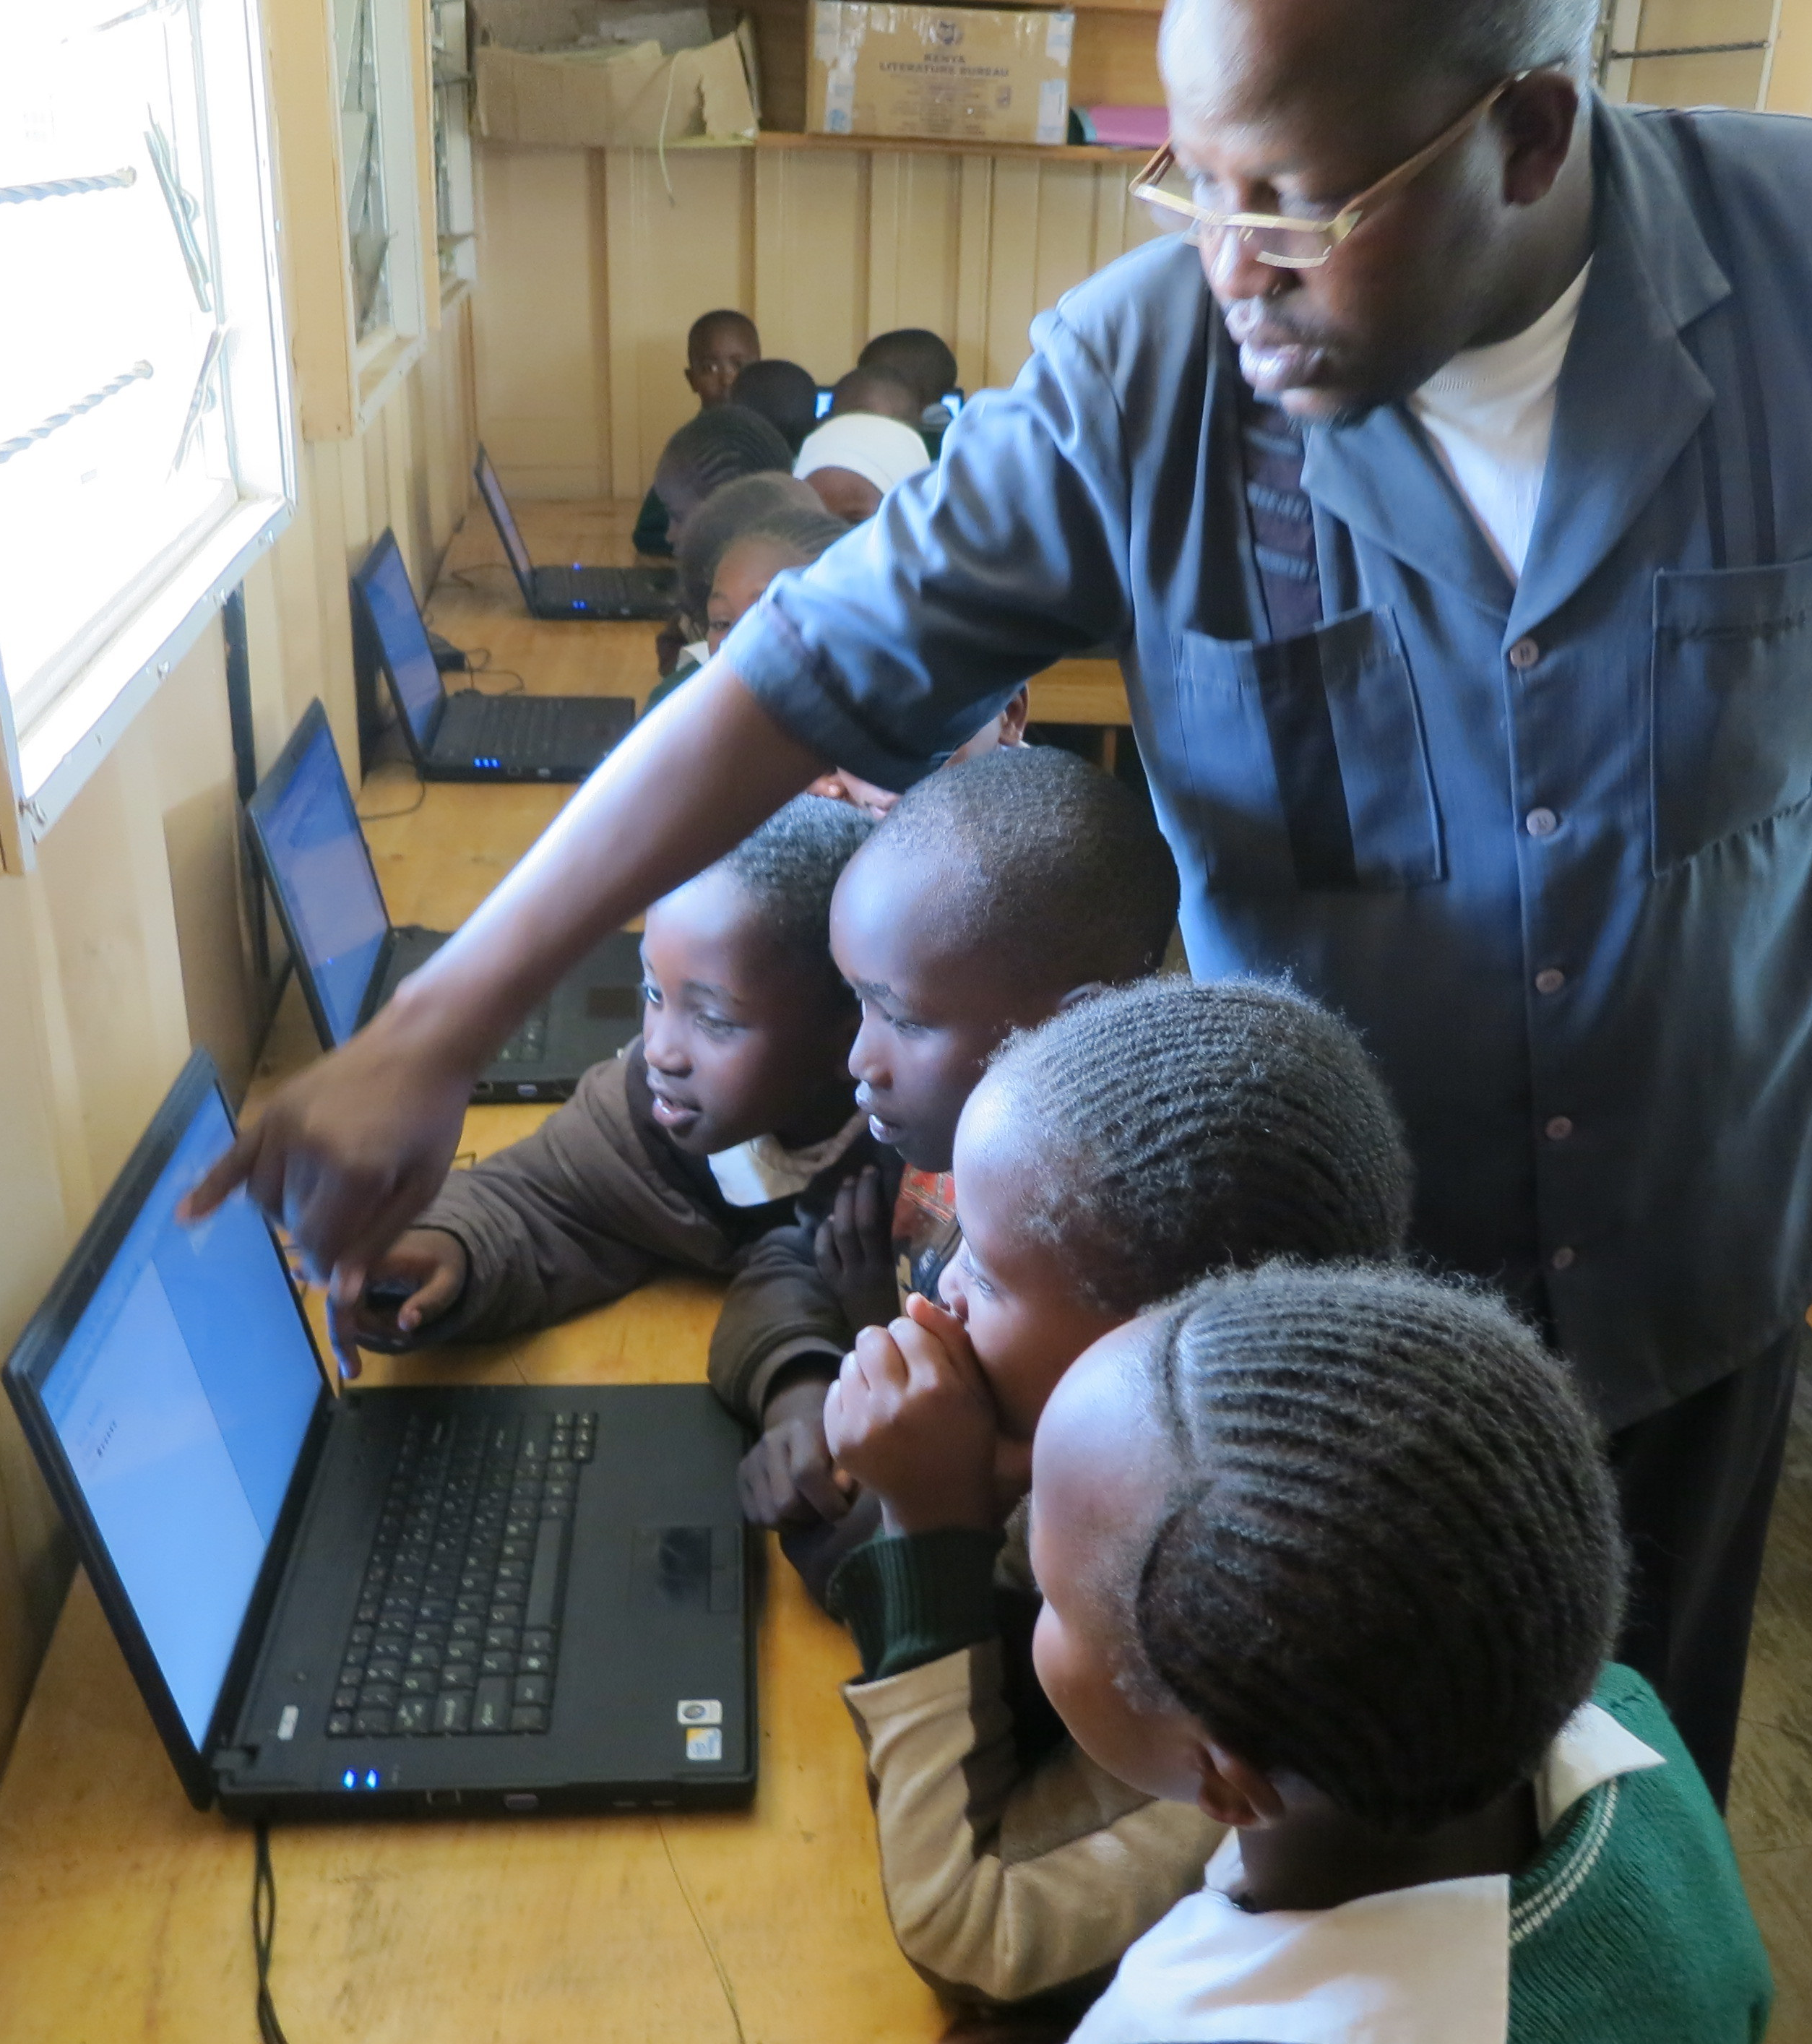
The computer center gives students opportunities for hands-on learning with the technology they will need for the future.

Slide 9
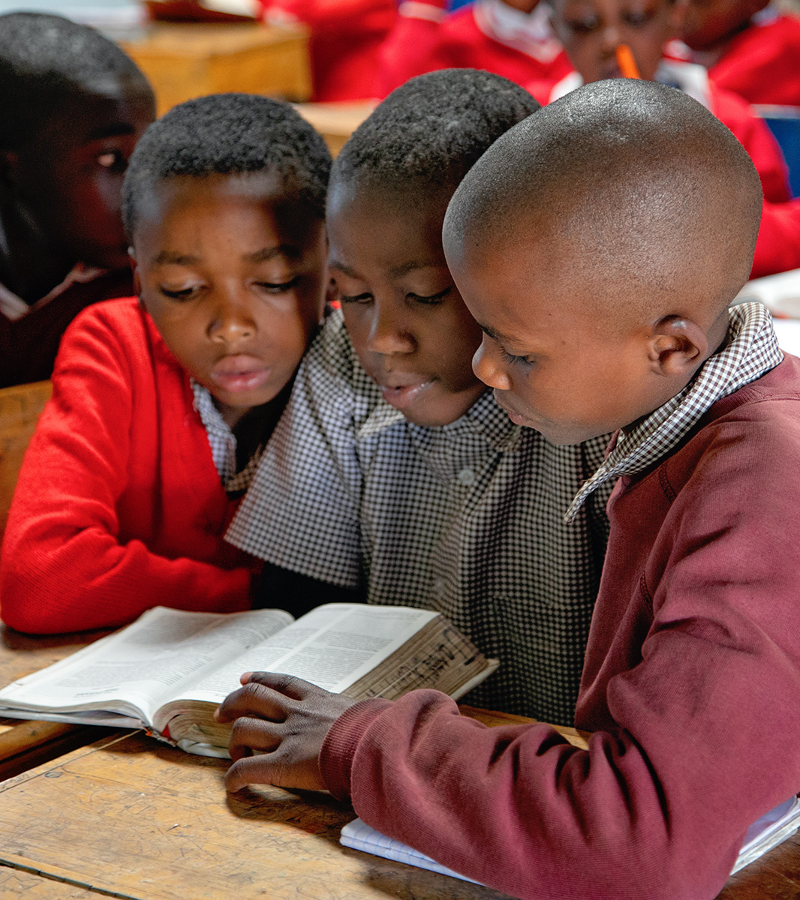
BIBLE PROGRAMS
At some of our schools, KKC teachers lead after-school bible programs. Students study the bible and memorize verses together.

Slide 10
Kenya Kids Can helps children thrive by partnering with their communities to provide hot lunches, an after-school bible program, and a computer education.
KenyaKidsCan.org

Slide 11
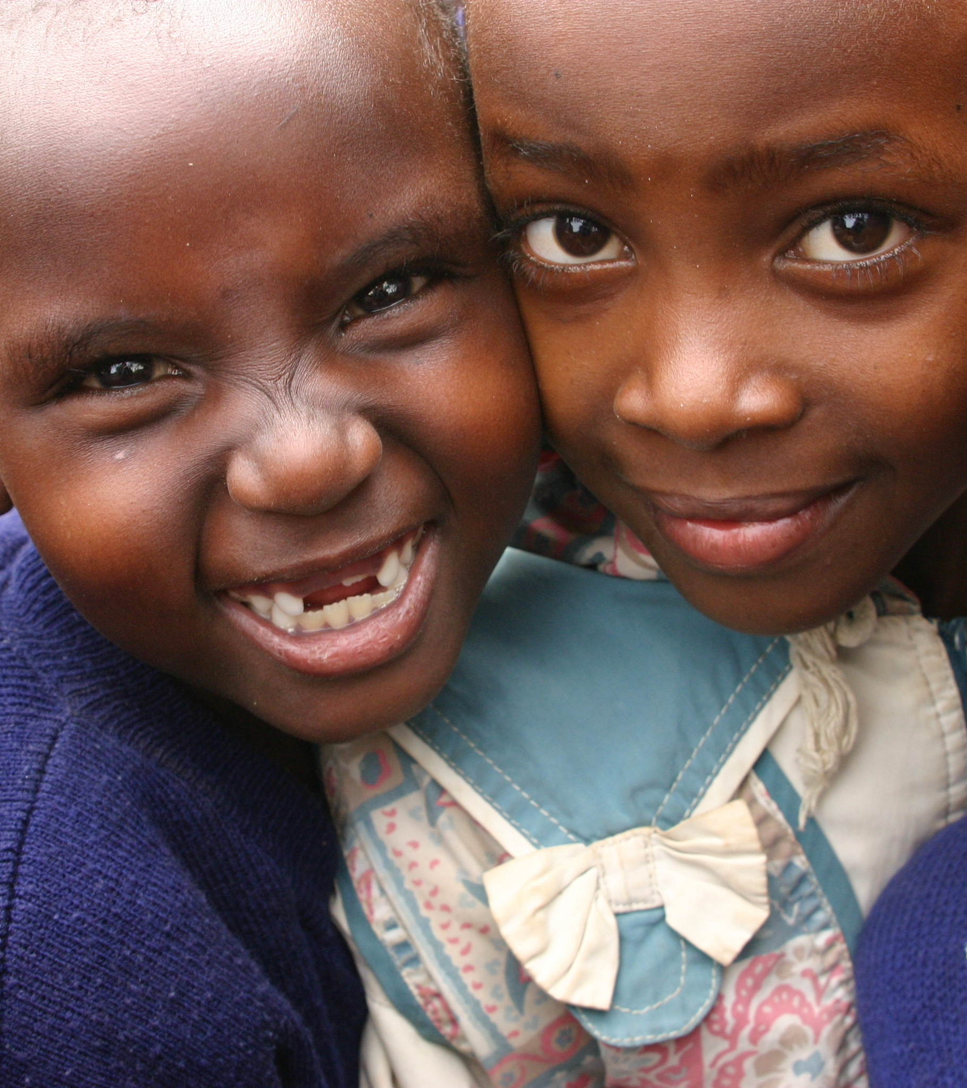

KENYA KIDS CAN
because of you!

