Slide 1

KenyaKidsCan.org

Slide 2
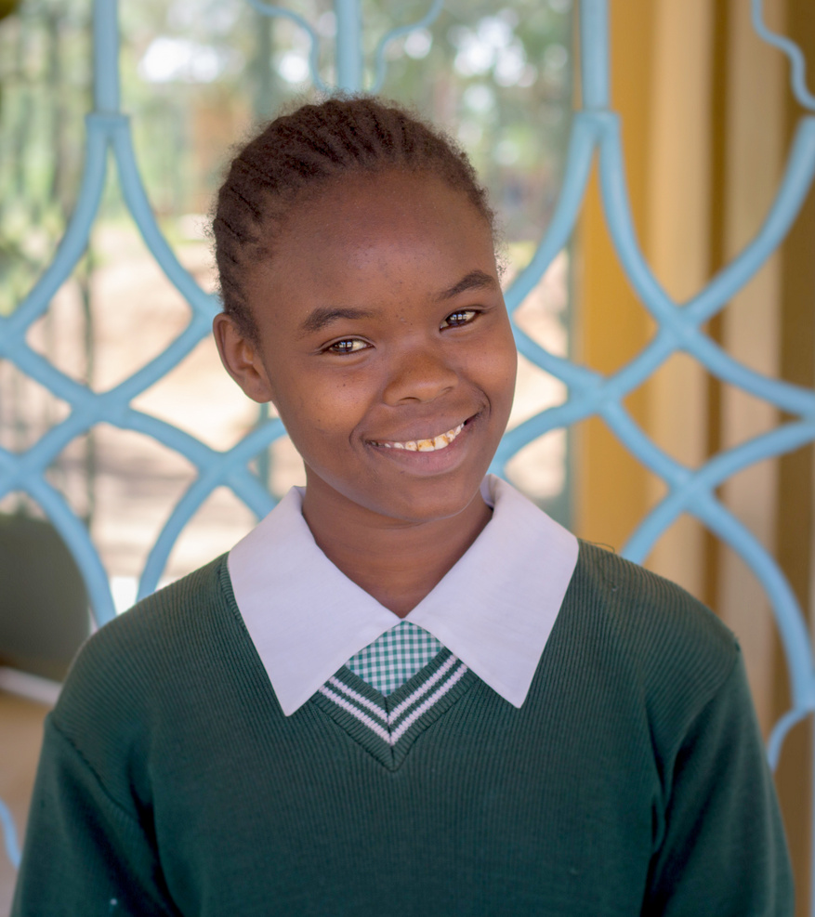
MEET LUCY,
a seventh grader at
Nyondia Primary School.
She lives with her aunt at the children’s home.
Her favorite subjects are Christian religious education and computer class.

Slide 3
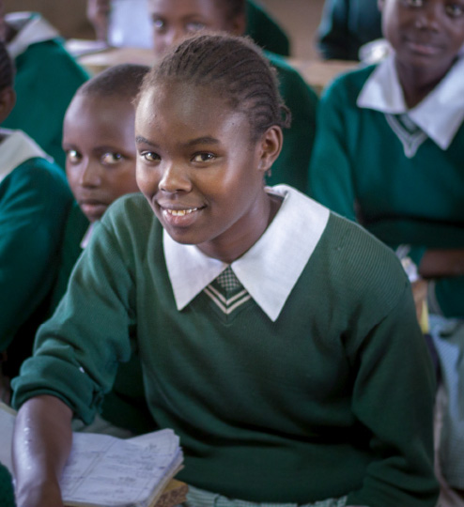
Lucy enjoys singing.

Slide 4


Listen to Lucy as she tells us why she likes to sing.

Slide 5
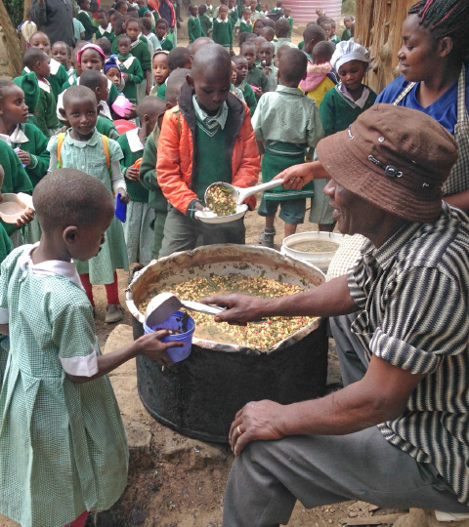
The students at Lucy’s school are a part of
the Kenya Kids Can
SCHOOL LUNCH PROGRAM.
They enjoy a hot lunch of githeri every day.

Slide 6
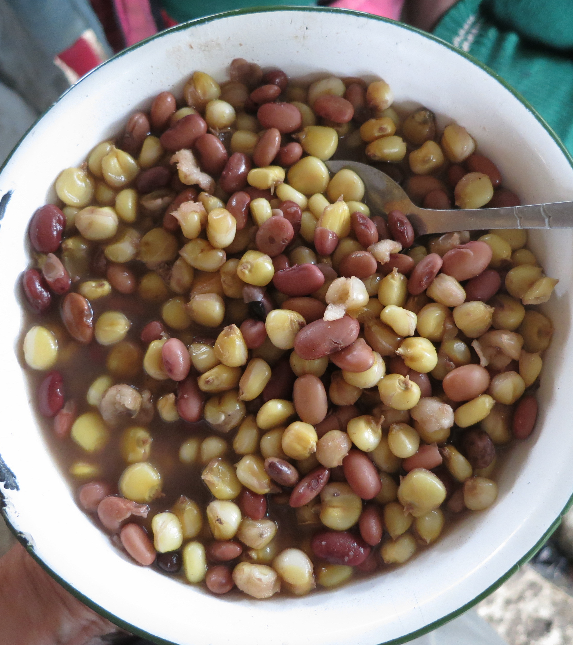
To make githeri, the school cooks soak dried maize and beans overnight. Then they simmer the mixture over a hot fire for several hours until the githeri is tender and ready to eat.

Slide 7
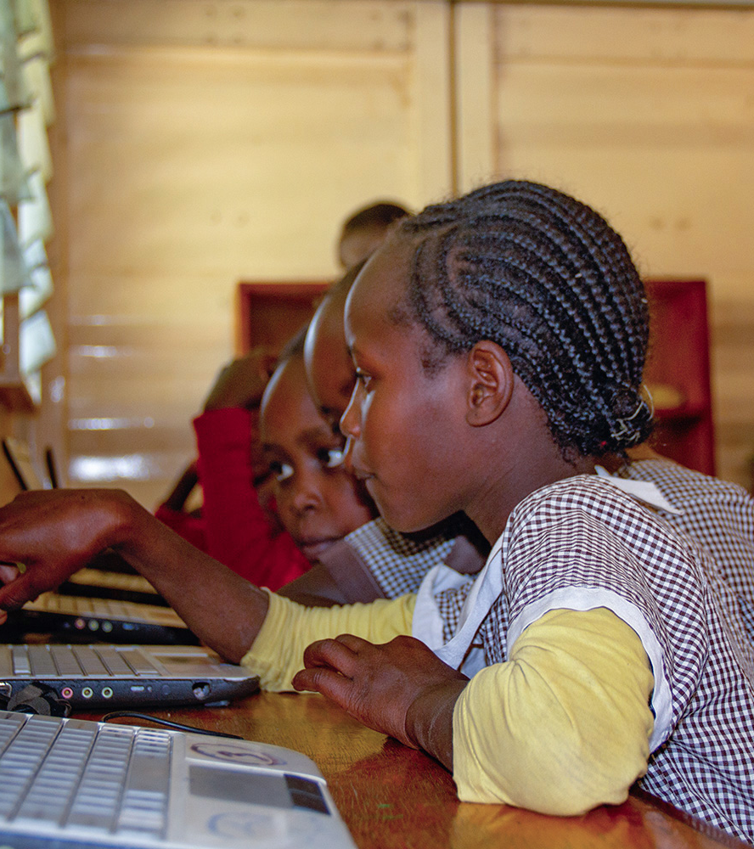
Kenya Kids Can operates a COMPUTER CENTER in Lucy’s school.
When students grow comfortable working with computers, they become better problem solvers in school and life.

Slide 8
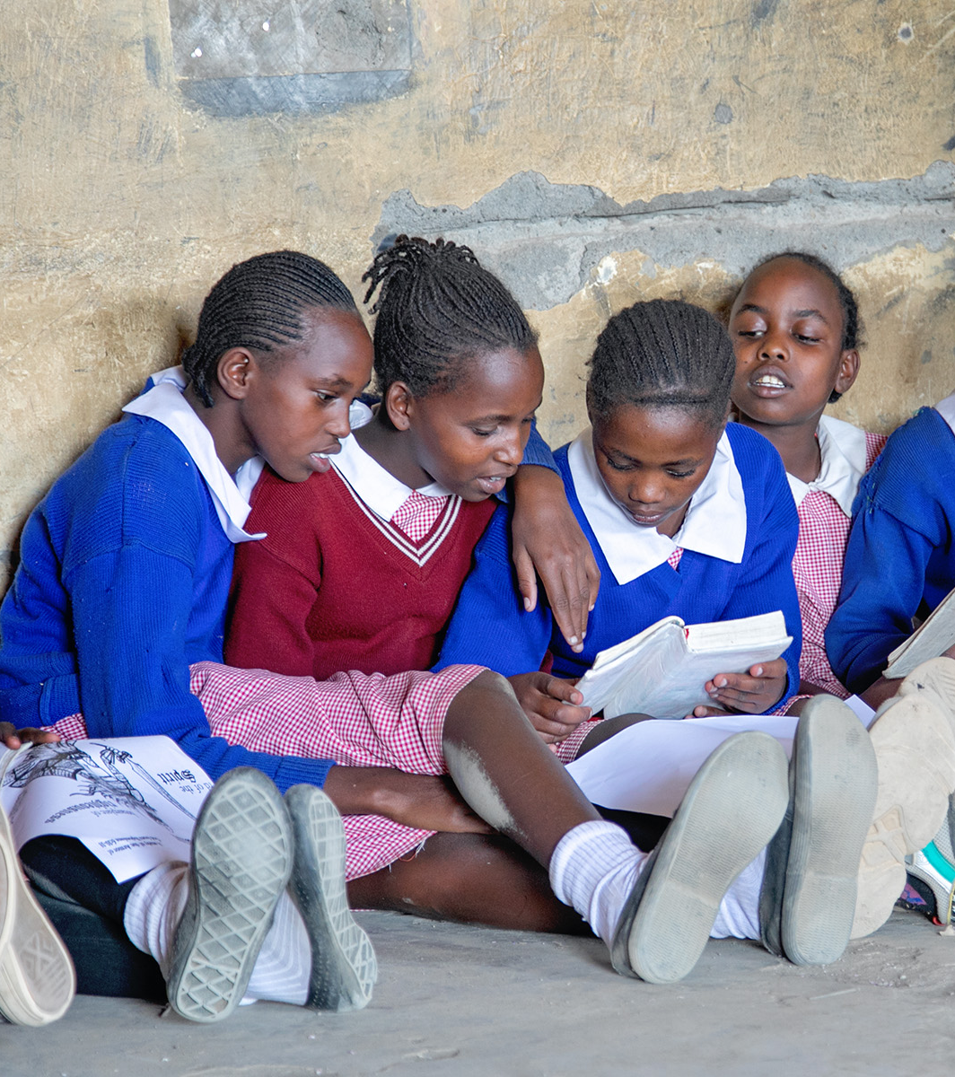
Kenya Kids Can also offers AFTER-SCHOOL BIBLE PROGRAMS in several of our schools. Students enjoy learning about God and reading stories about people in the bible.

Slide 9
Kenya Kids Can helps children thrive by partnering with their communities to provide hot lunches, an after-school bible program, and a computer education.
KenyaKidsCan.org

Slide 10
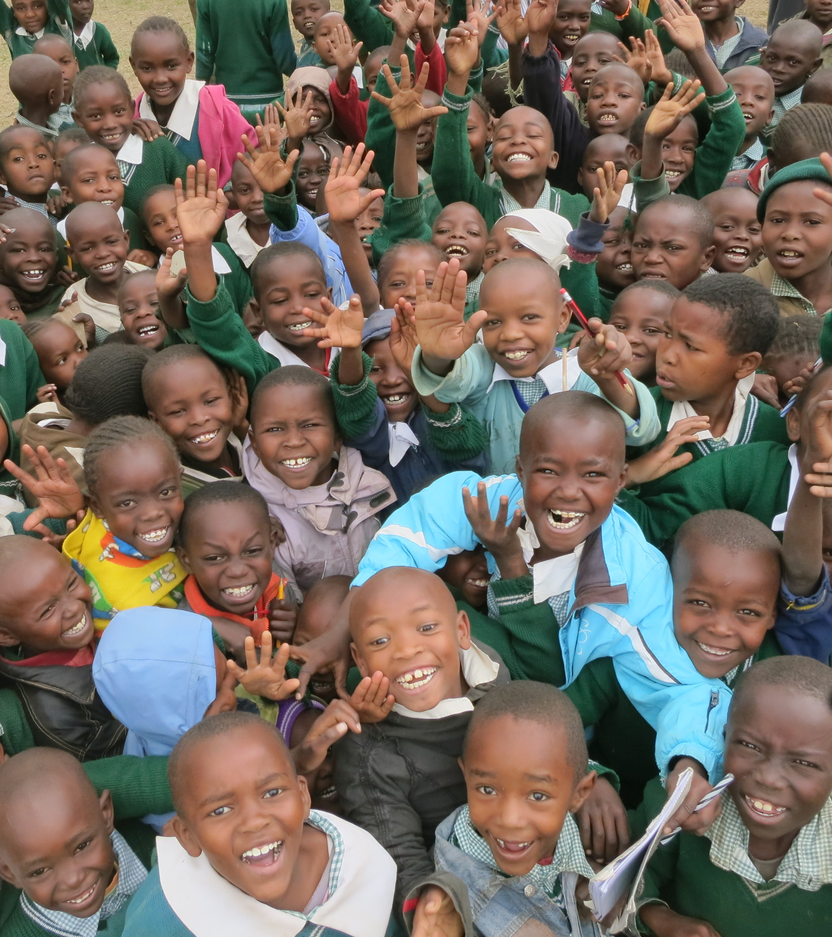

KENYA KIDS CAN
because of you!

