Slide 1

KenyaKidsCan.org

Slide 2
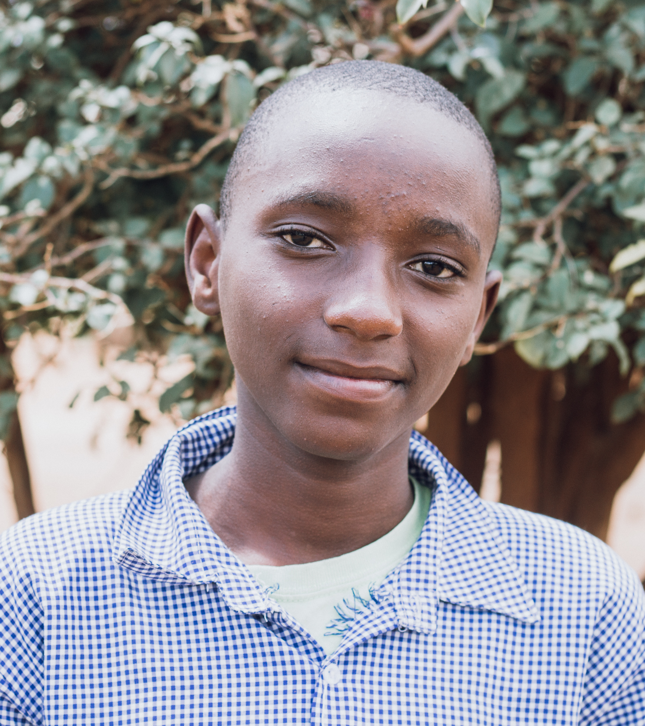
MEET NATHAN,
a seventh grader at
Ngeya Comprehensive School.
He has three sisters.
His favorite subjects are computer class, math, and science.

Slide 3
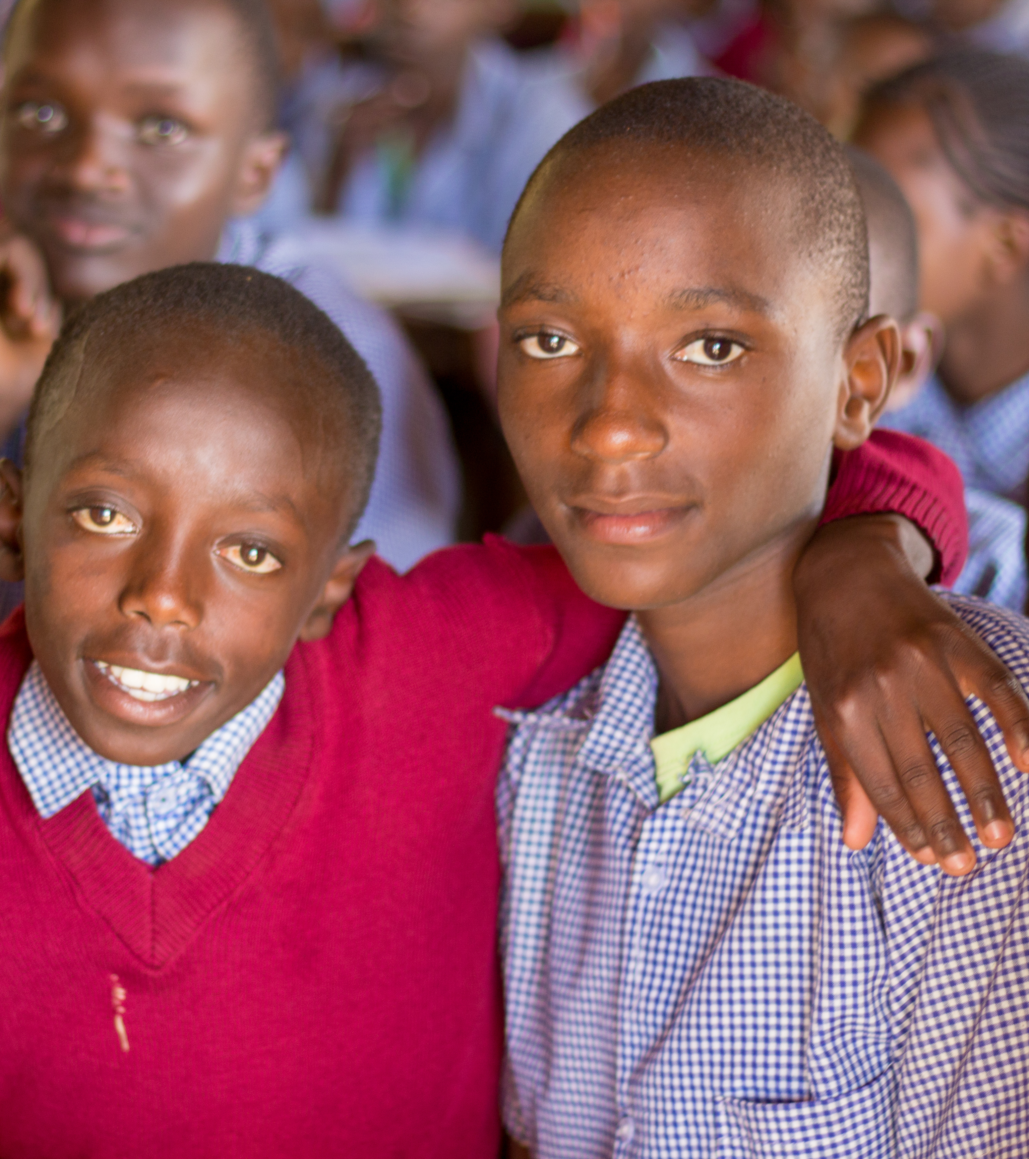
Nathan wants to be a mechanical engineer.

Slide 4


Slide 5
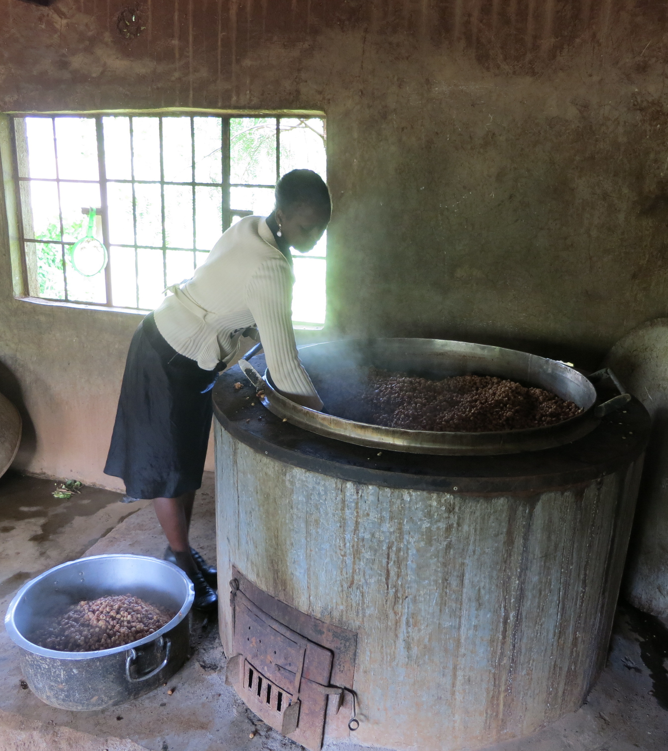
Nathan’s school is part of
Kenya Kids Can’s SCHOOL LUNCH PROGRAM.
His community wants to see all the children in his school learn and grow.
That’s why they built a kitchen, hired cooks, and find firewood and water needed for cooking every day.

Slide 6
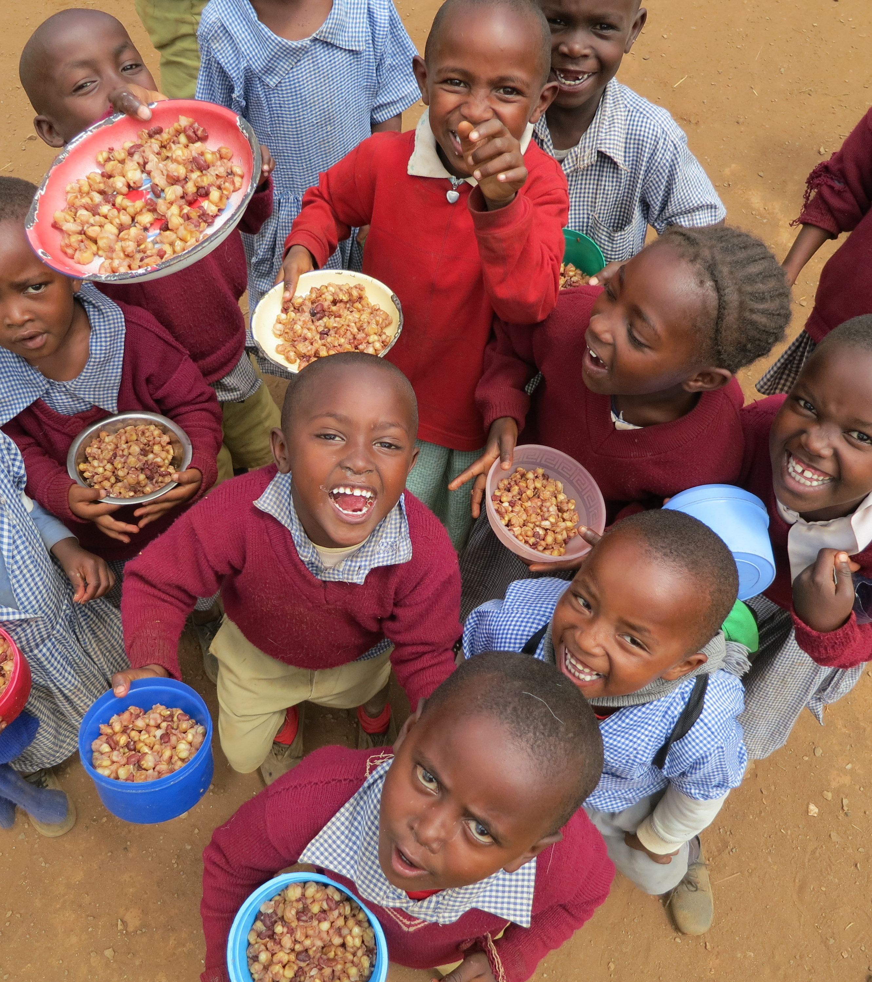
The one thing his community can’t afford to do is purchase the corn and beans that make up the simple meal of githeri.
Kenya Kids Can forms
the link between you and Nathan’s community to
provide food for lunch.

Slide 7
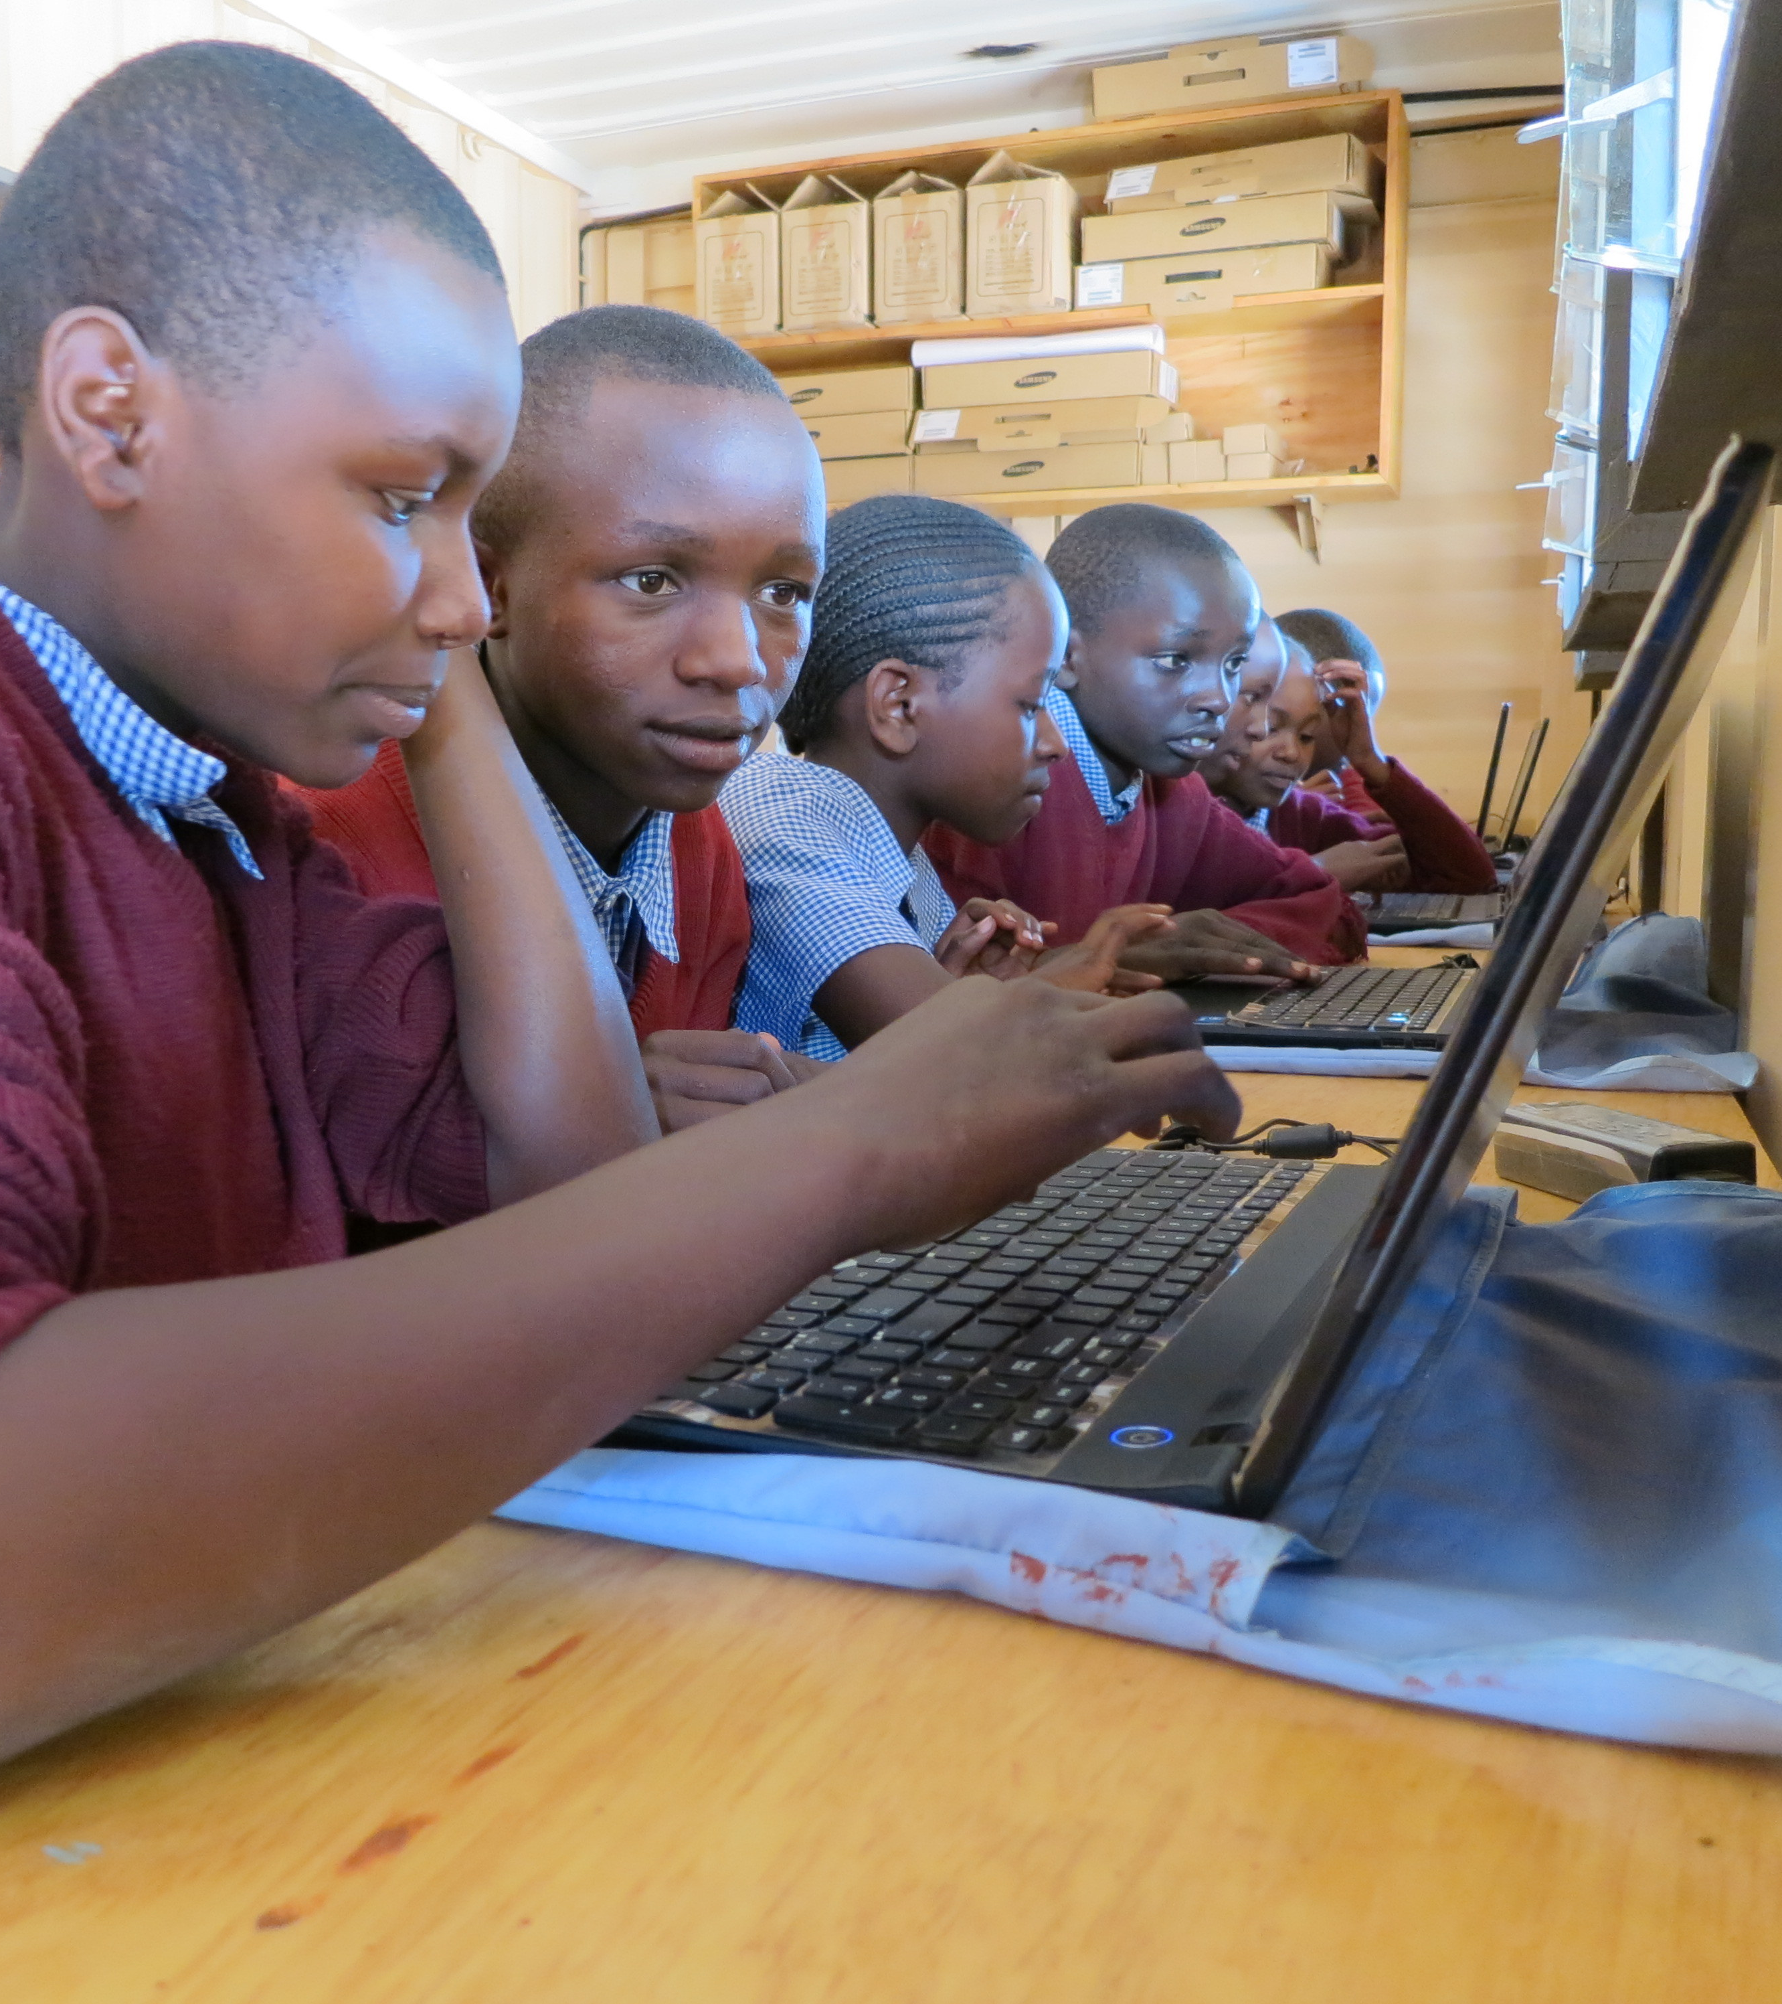
COMPUTER CENTERS
Kenya Kids Can also operates a computer center in Nathan’s school.
Learning how to work on a computer helps Nathan and his classmates prepare for the future.

Slide 8
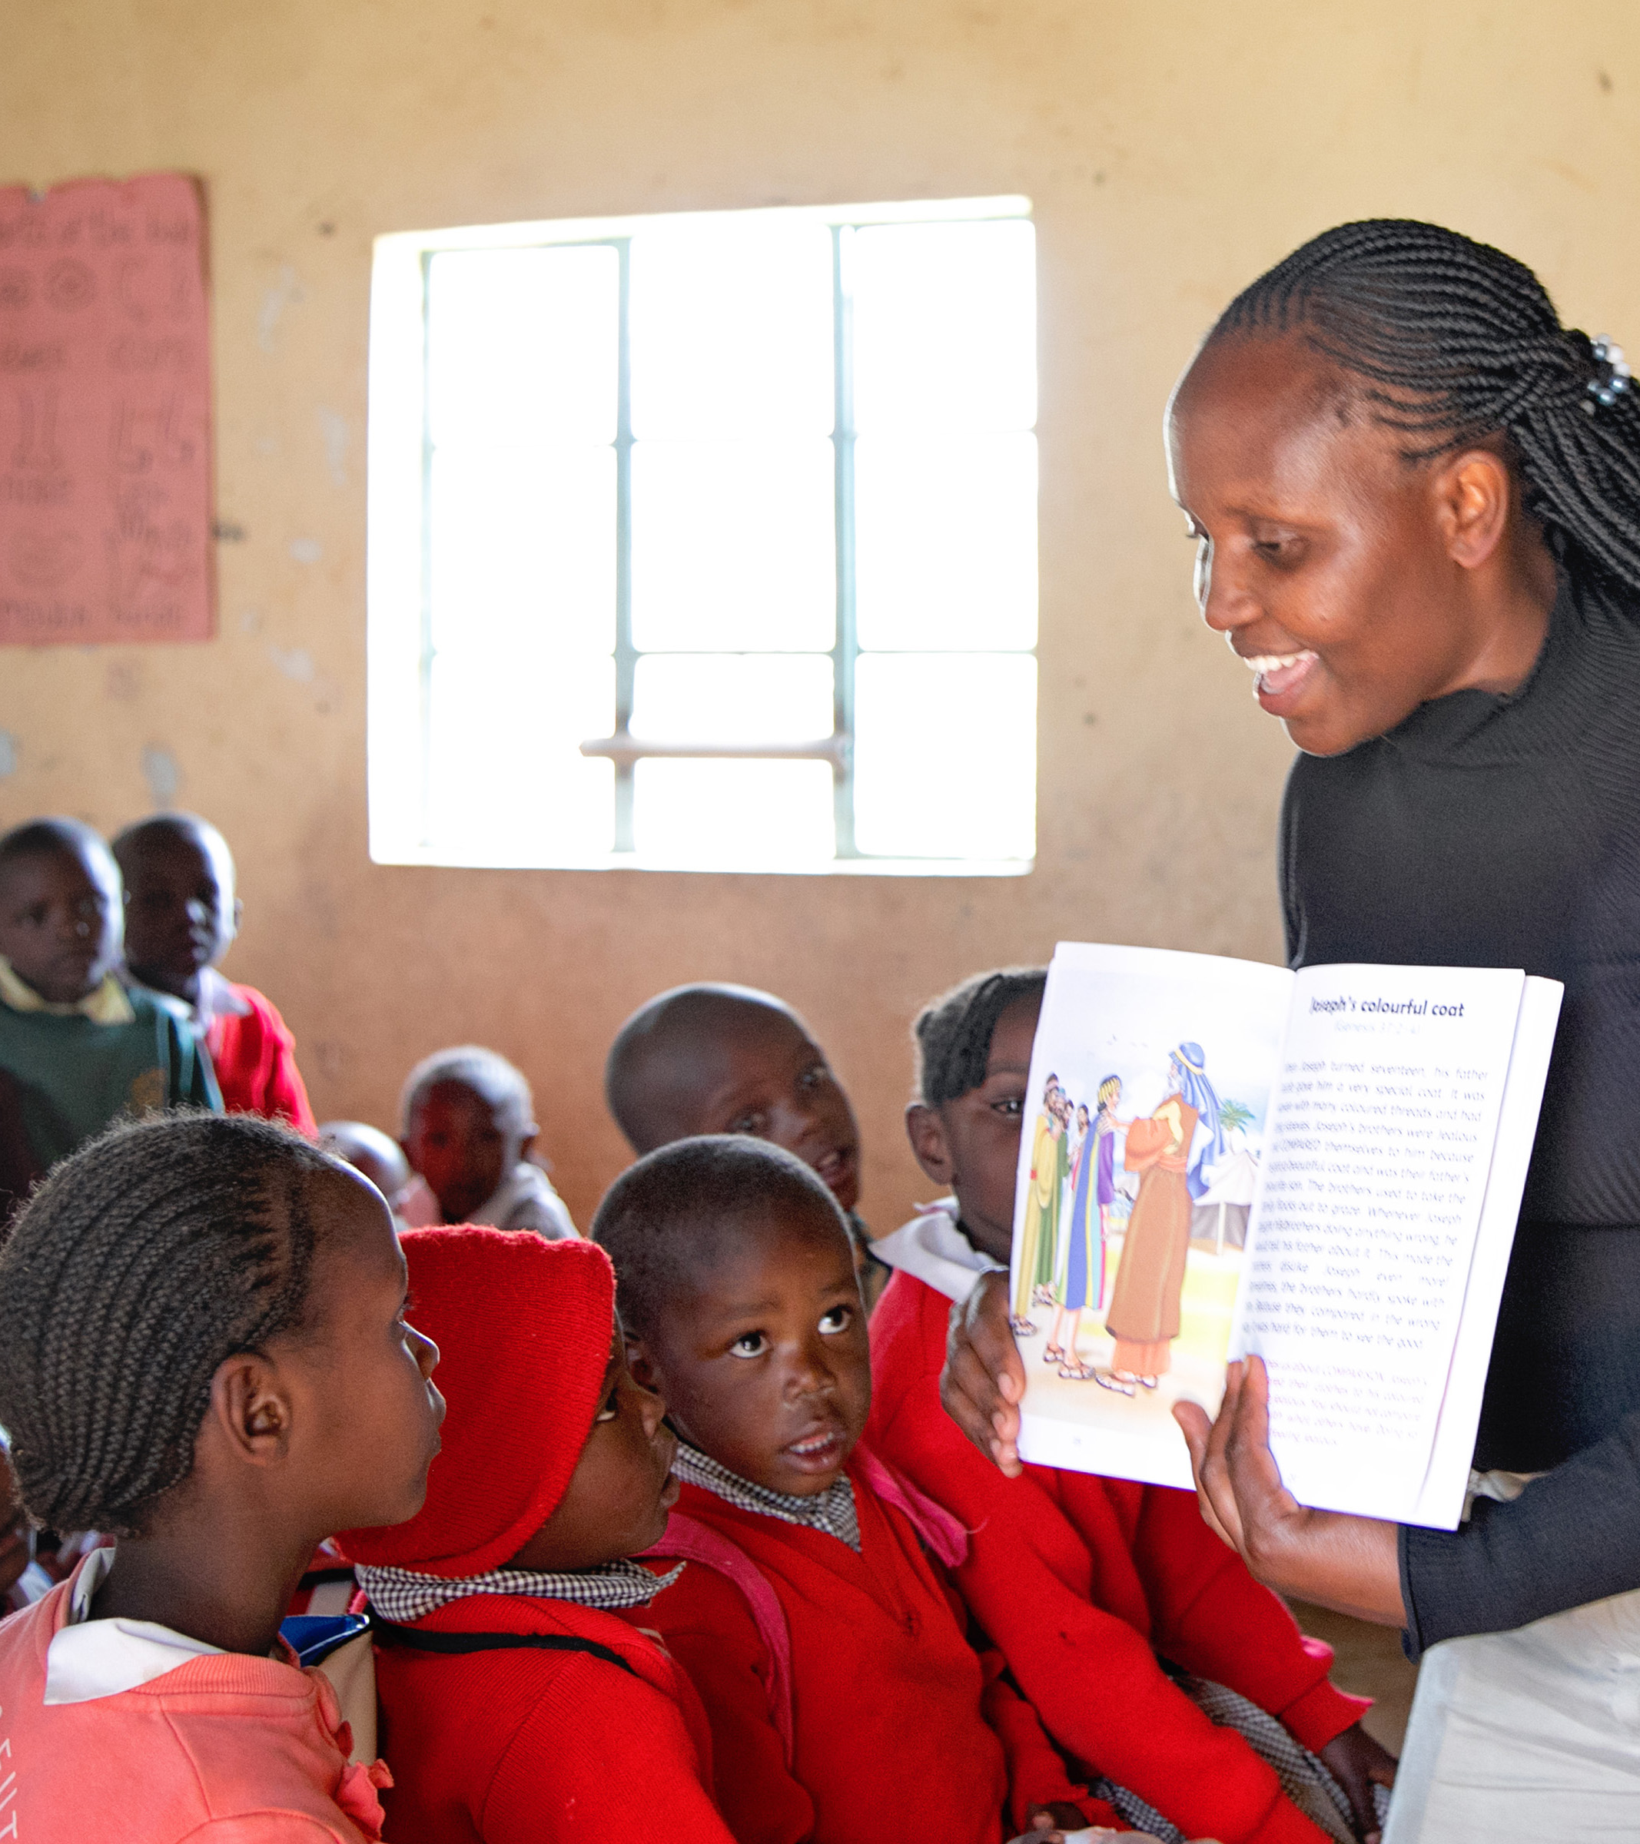
BIBLE PROGRAM
Some of our schools also have an after-school bible program, where students learn about God’s love and care for them.

Slide 9
Kenya Kids Can helps children thrive by partnering with their communities to provide hot lunches, an after-school bible program, and a computer education.
KenyaKidsCan.org

Slide 10
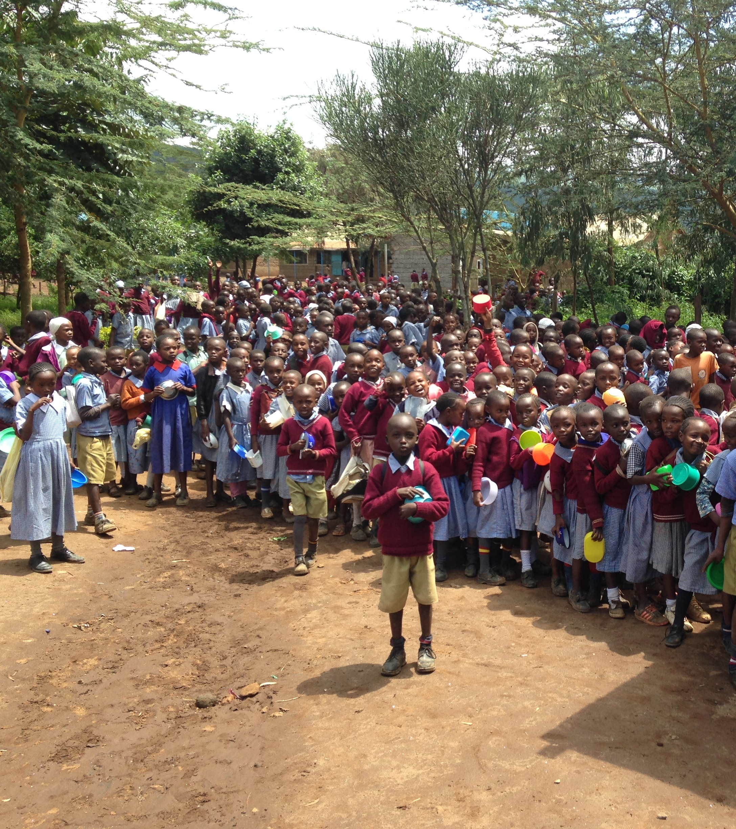

KENYA KIDS CAN
because of you!

