Slide 1

KenyaKidsCan.org

Slide 2

MEET TIMOTHY,
a sixth grader at
Nyakinyua Primary School.
His favorite subject is Swahili.
Every day, he and his sister walk for 45 minutes to get to school.

Slide 3

Timothy wants to fly.

Slide 4


Slide 5
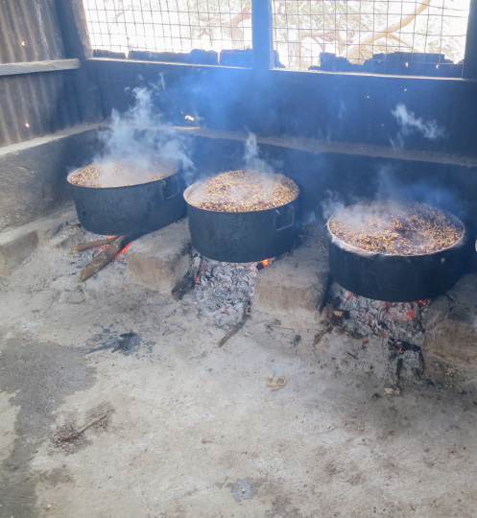
SCHOOL LUNCH PROGRAM
Timothy’s community and Kenya Kids Can provide students with a hot meal every school day.

Slide 6
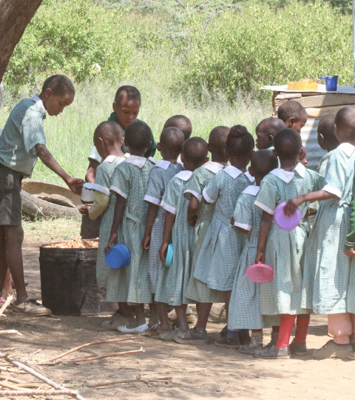
The children bring clean bowls from home to receive their lunches.

Slide 7
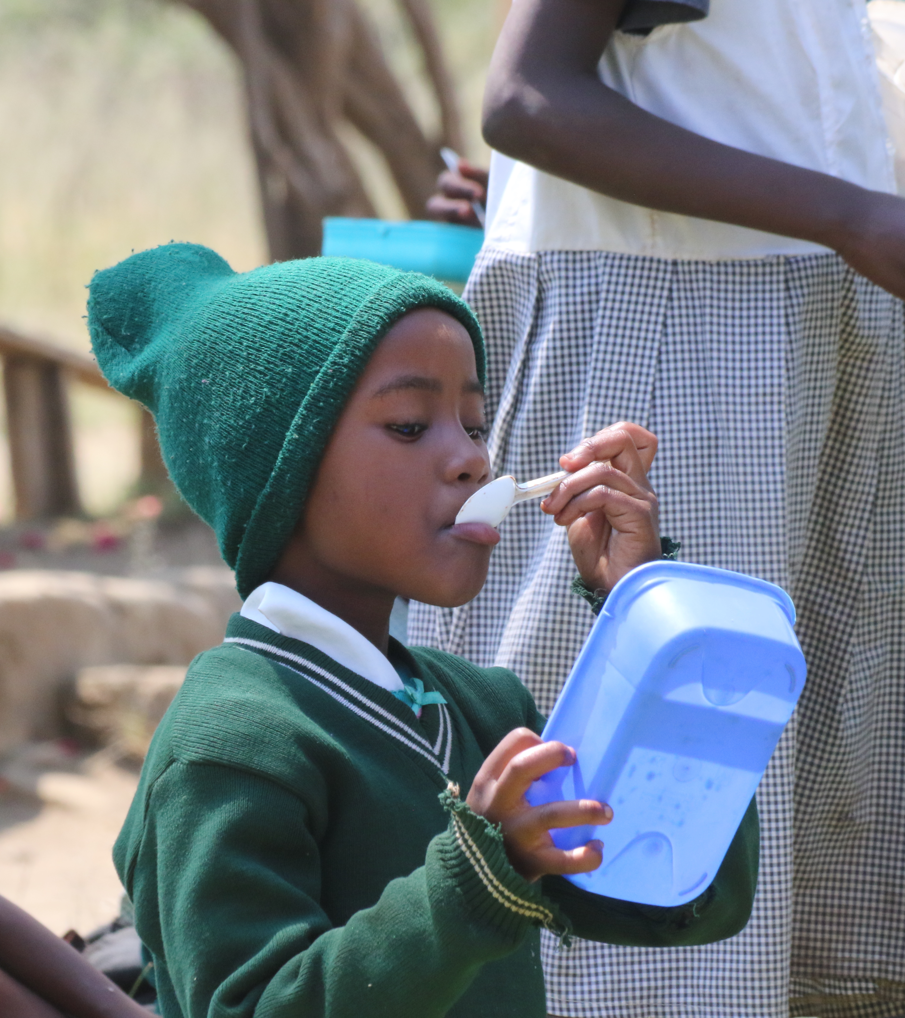
When lunch is served,
it keeps the students warm and gives them the energy to learn.
And when they learn, they’re equipped as the future problem solvers of Kenya.

Slide 8
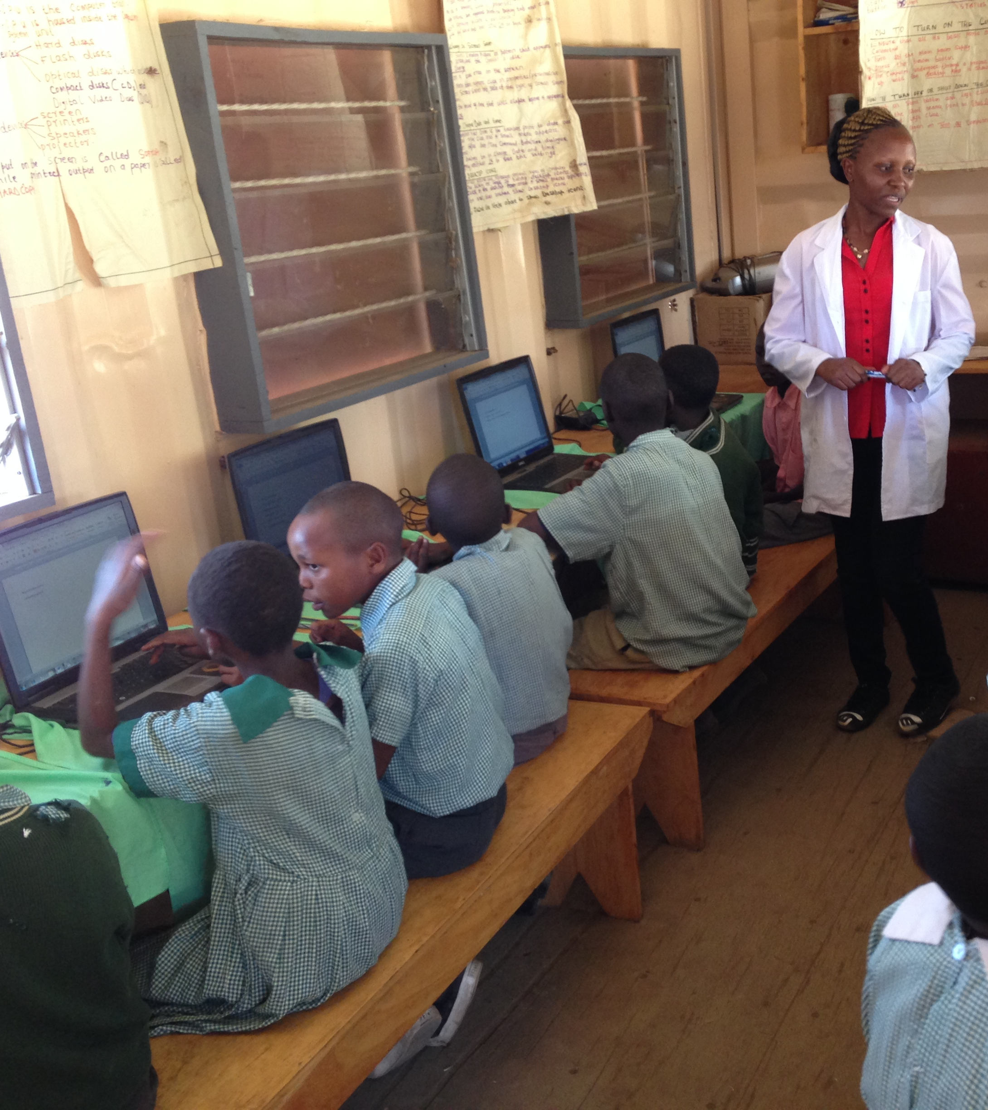
COMPUTER CENTERS
In addition to helping Timothy’s community feed their children, Kenya Kids Can also operates a computer center in his school.

Slide 9
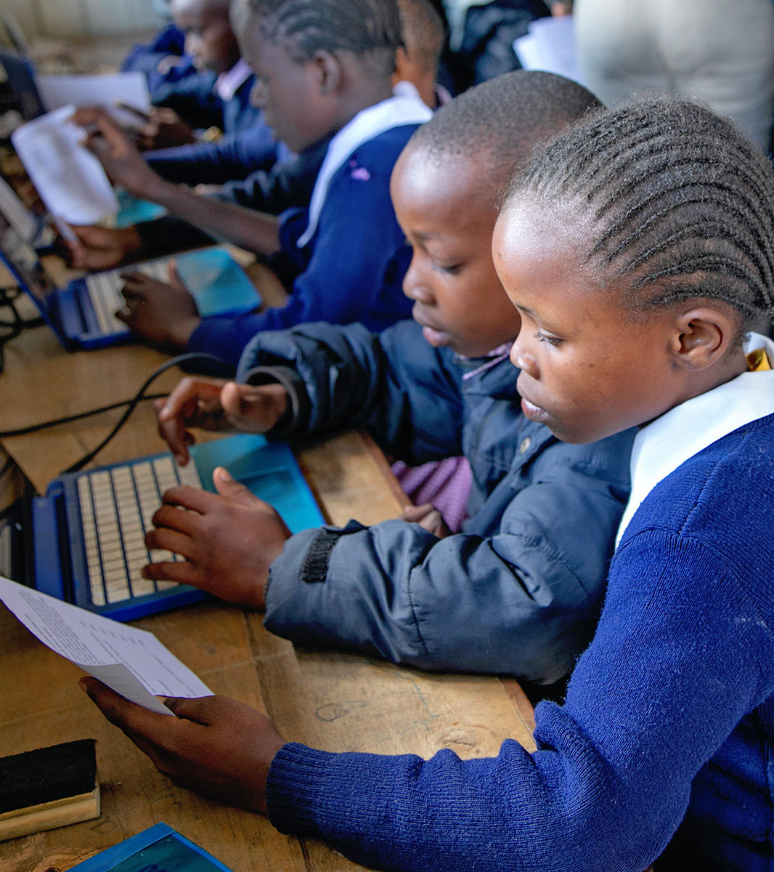
Learning how to use a computer helps students gain the skills they’ll need for the future.

Slide 10
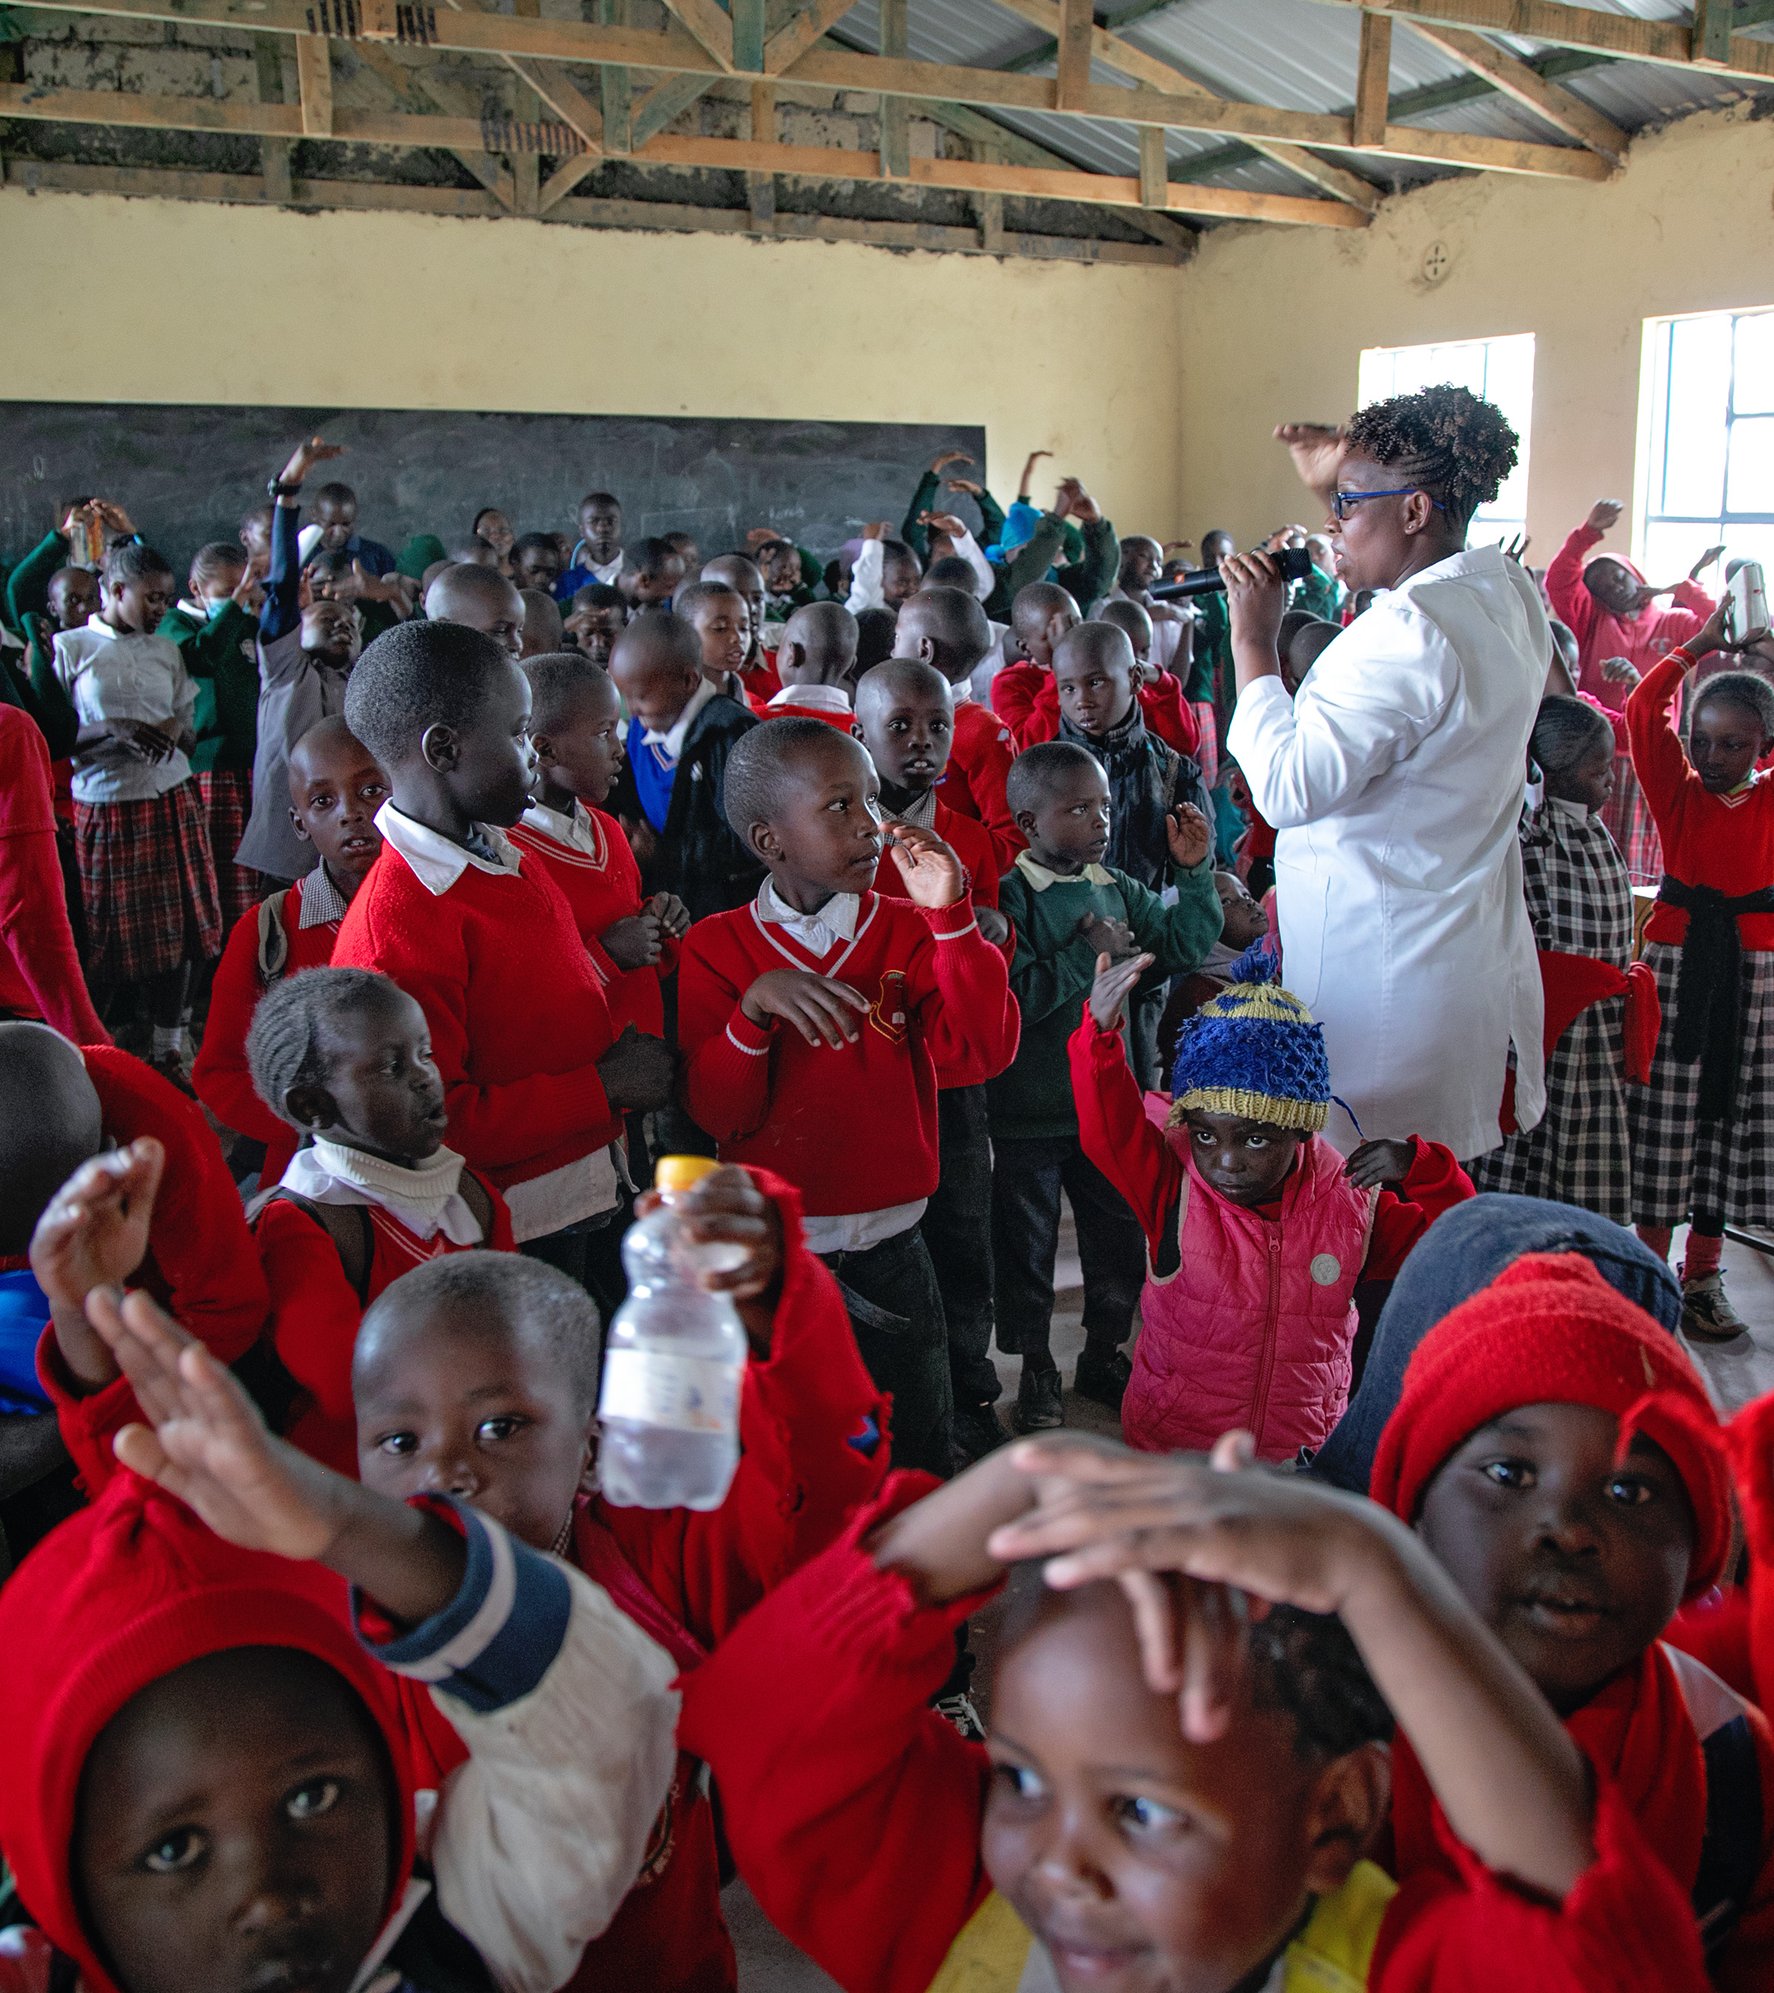
BIBLE PROGRAM
Several of our schools also have an after-school bible program where students sing, listen to bible lessons, and learn about God’s love for them.

Slide 11
Kenya Kids Can helps children thrive by partnering with their communities to provide hot lunches, an after-school bible program, and a computer education.
KenyaKidsCan.org

Slide 12
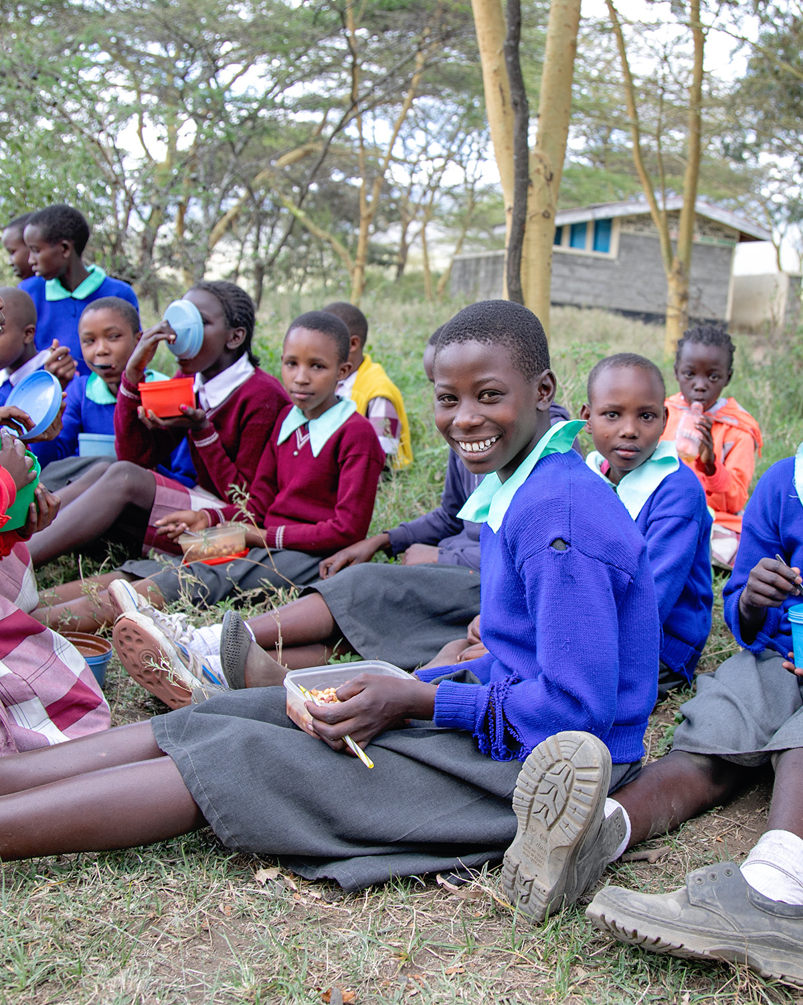

KENYA KIDS CAN
because of you!

